Slide 1
THE NATIONAL DEGREE COLLEGE BAGEPALLI-561207
DEPARTMENT OF COMPUTER SCIENCE BACHELOR OF COMPUTER APPLICATIONS
“RAINFALL PREDICTION USING MACHINE LEARNING”
GROUP UNDER THE GUIDENCE OF
BHARATH K SRIHARI KV M.sc
DEVARAJ YS ASSISTENT PROFESSOR
GAGAN L Dept.of Computer Science

Slide 2
Agenda
Abstract
Importance
Problem definition
Introduction
Methodology
Hardware and Software Requierements
Conclusion and Future Enhancement

Slide 3
Abstract
India is an agricultural country and its economy is largely based upon crop productivity and rainfall.
For analyzing the crop productivity, rainfall prediction is require and necessary to all farmers.
Rainfall prediction is a beneficiary one, but it is a challenging task. Machine learning techniques can use computational methods and predict rainfall by retrieving and integrating the hidden knowledge from the linear and non-linear patterns of past weather data.
Using different data mining techniques it can predict rainfall. Data mining techniques are used to estimate the rainfall numerically.

Slide 4
Importance of Rainfall Prediction
Agriculture and Water Management
Accurate rainfall predictions aid farmers in planning their crops and irrigation needs, optimizing water usage and improving yields
Infrastructure Planning
Rainfall data informs the design and maintenance of roads, bridges, and drainage systems, ensuring they can withstand changing precipitation patterns
Disaster Mitigation
Early warning of heavy rainfall can help authorities prepare for and mitigate the impact of floods, landslides, and other weather-related disasters.

Slide 5
Problem Definition
The goal of this project is to develop a machine learning model that can predict rainfall accurately based on historical weather data. The model should handle a variety of input features, such as temperature, humidity, wind speed, atmospheric pressure, and past rainfall data, to provide reliable forecasts.

Slide 6
Introduction
Rainfall Prediction is one of the most challenging tasks. Though already many algorithms have being proposed but still accurate prediction of rainfall is very difficult.
In an agricultural country like India, the success or failure of the crops and water scarcity in any year is always viewed with greatest concern.
A small fluctuation in the seasonal rainfall can have devastating impacts on agriculture sector.
Accurate rainfall prediction has a potential benefit of preventing causalities and damages caused by natural disasters
Using various data mining techniques to develop Rainfall prediction model Such as classification, clustering, decision tree and also neural networks
Under certain circumstances such as flood and drought, highly accurate rainfall prediction is useful for agriculture management and disaster prevention. In this project, various algorithms have been analysed.
Data mining techniques are efficiently used in rainfall prediction.

Slide 7
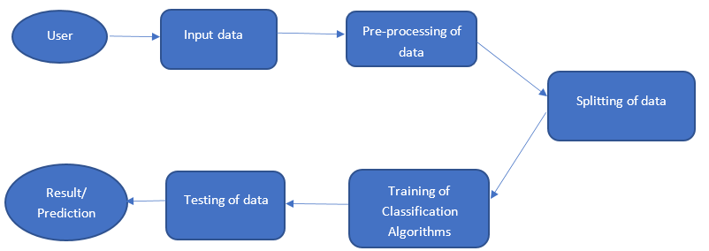
Methodology

Slide 8
Hardware and Software Requirements of Rainfall Prediction
Hardware requirements
Operating System – Windows7/10
Speed - 2.4GHZ
Hard disk - 500GB
Monitor - 15VGA
Ram - 4GB
Software requirements
Programming languages - Python
Application - Visual studio
Libraries - numpy,pandas,matplotlib,seaborn,
sklearn, xgboost

Slide 9
Conclusion
Accuracy and Reliability: The model demonstrated consistent accuracy
in predicting rainfall patterns over the test period.
Impact on Decision-Making: Reliable predictions enable better preparedness for agriculture
urban planning, and disaster management.
Limitations and Future Scope: Acknowledging the model's limitations, further enhancements
in data granularity and modeling techniques can improve forecast precision.
Community and Stakeholder Engagement: Collaborative efforts with meteorologists, local
communities, and policymakers are crucial for effective utilization and dissemination of predictions
.
Continued Research: Ongoing research should focus on integrating advanced machine
learning algorithms and real-time data updates to enhance predictive capabilities.

Slide 10
Fucture Enhancement
The future enhancements we can apply to our project to improve its performance and accuracy. For rainfall prediction, we have only suggested one technique, and it has both advantages and disadvantages compared to other algorithms. Even so, we were unable to predict rainfall at various locations with a 100% accuracy rate. In order to accurately predict when it will rain, a mix of algorithms must be constructed and applied in real time. Due to the dynamic nature of rainfall factors and how many distinct real-world scenarios they are affected by, a model that has superior data pretreatment and optimization techniques may yield better results. In the future, there will be additional

Slide 11
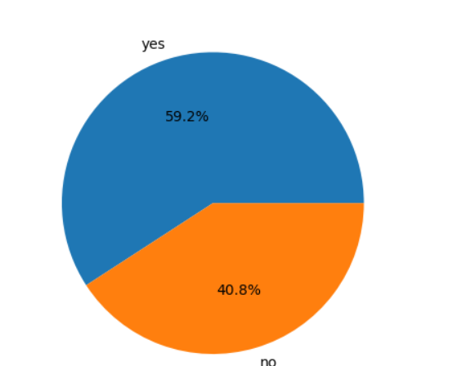
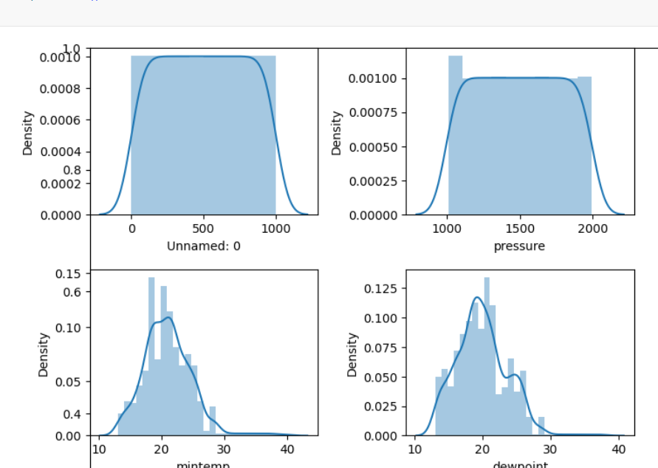
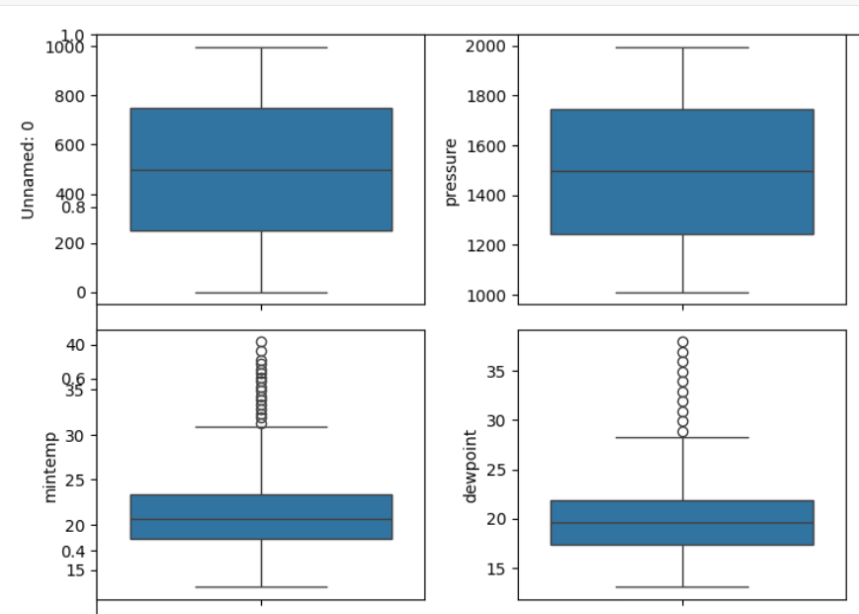
Box plot
Pie Chart
Histogram

Slide 12
Thank You

